Slide 1
Sector-specific Stock Price Forecasting
A Comparative Analysis of Time Series Models for S&P 500 Industries
Presenters: Harsh Patel, Mingli Xu
Mentor: Hyoeun Lee

Slide 2

Introduction
Our study aims to identify the best time series model for predicting stock prices of different sectors in the S&P 500.
We compare traditional models, including Linear Regression, ARIMA, and ARCH model, to the more recent learning methods such as LSTM.
Our findings provide insights into effective modeling techniques for predicting stock prices of different business sectors, which can be useful for investors and analysts in making informed investment decisions.
Photo by Pexels
Notes:
mingli

Slide 3
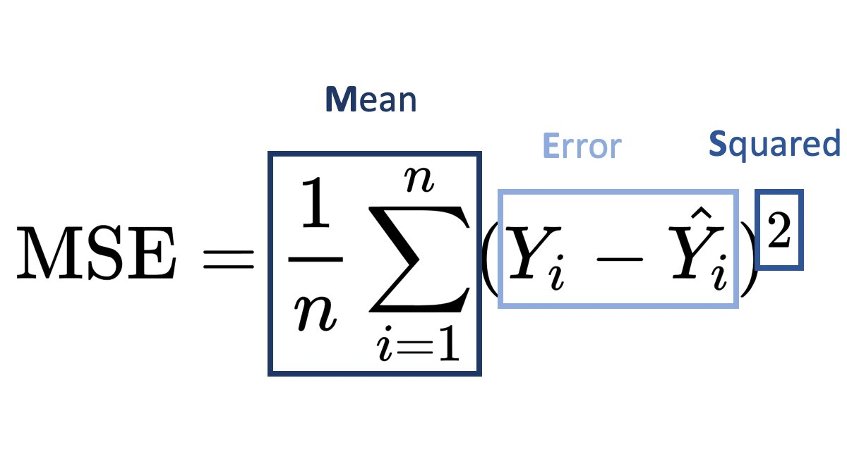

Metric - MSE
MSE (Mean Squared Error) measures the difference between the predicted and actual stock prices
Calculation: MSE is calculated by averaging the squared difference between predicted and actual values
Interpretation: Lower MSE values indicate a better fit of the model to the data
Photo by Pexels
Notes:
harsh

Slide 4
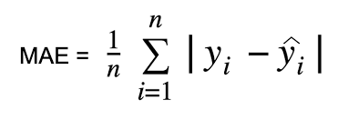
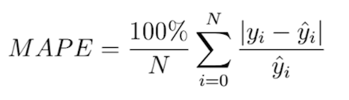
Metric - MAE, MAPE
MAE(Mean absolute Error) measures the average size of the mistakes in a collection of predictions, without taking their direction into account.
It is measured as the average absolute difference between the predicted values and the actual values.
MAPE(Mean absolute percentage error) is the percentage equivalent of mean absolute error.
It measures the average magnitude of error produced by a model, or how far off predictions are on average.
We decided to use MSE as our baseline metric to determine the results of our findings.
Reasons for using MSE
It penalizes large errors more heavily than small errors
It’s a well-understood and widely-used metric in statistical analysis
Also most commonly used to evaluate the quality of a forecasting model or predictor
Photo by Pexels
Notes:
Add why chose MSE
Harsh
.

Slide 5

Traditional Models
Linear Regression model: the relationship between the dependent variable and one or more independent variables is assumed to be linear.
ARIMA model: relies on identifying patterns in the data to make forecasts.
ARCH model: focuses on capturing the volatility of the data.
Photo by Pexels
Notes:
Mingli

Slide 6
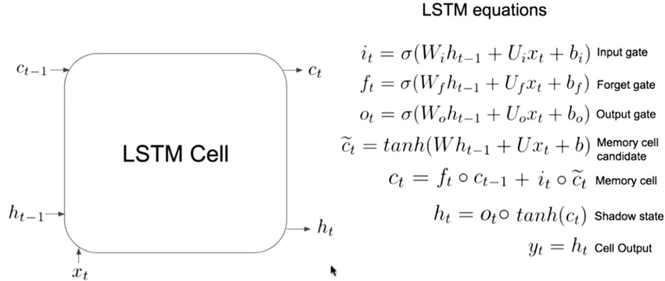
Machine Learning Methods
Long Short-Term Memory (LSTM) : Allows certain information to be added or removed from the cell state and is regulated by gates. Instead of removing all the data, certain features are targeted and allow better prediction of the data
Photo by Pexels
Notes:
Harsh

Slide 7

Data Summary
SPY
Biotech companies:
Shares Biotechnology (IBB)
Moderna (MRNA)
Energy sector (XLE)
Financial sector (XLF)
Real Estate sector (XLRE)
Large Market Cap Tech company: Apple (AAPL)
Photo by Pexels
Notes:
Mingli

Slide 8
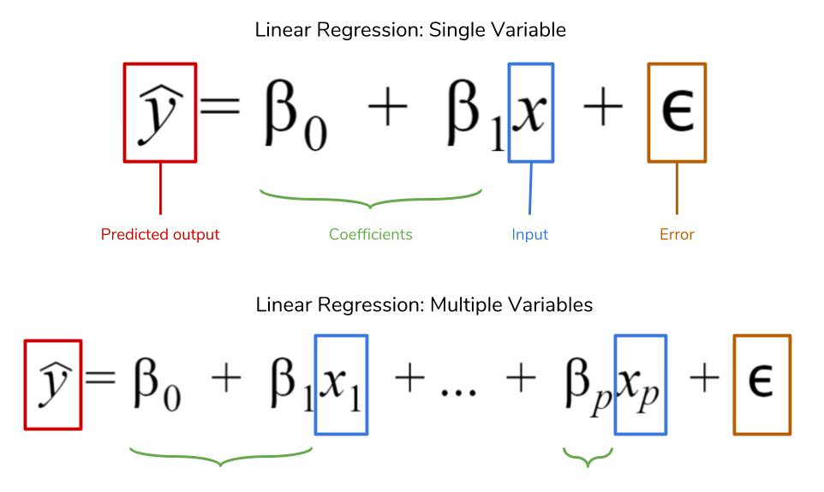
Traditional Models-Linear Regression
The relationship between the dependent variable (Close stock price) and the independent variable (Date) is assumed to be linear.
Photo by Pexels

Slide 9
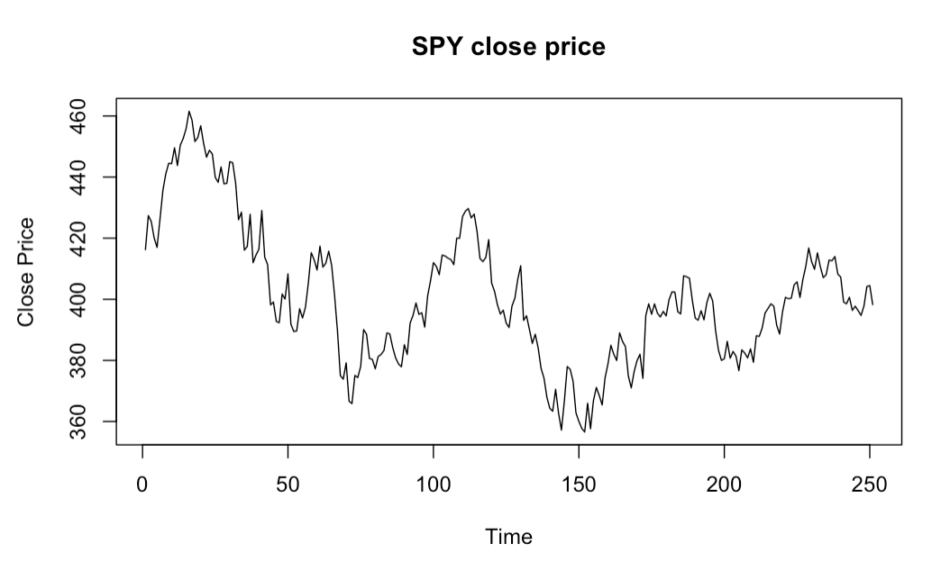
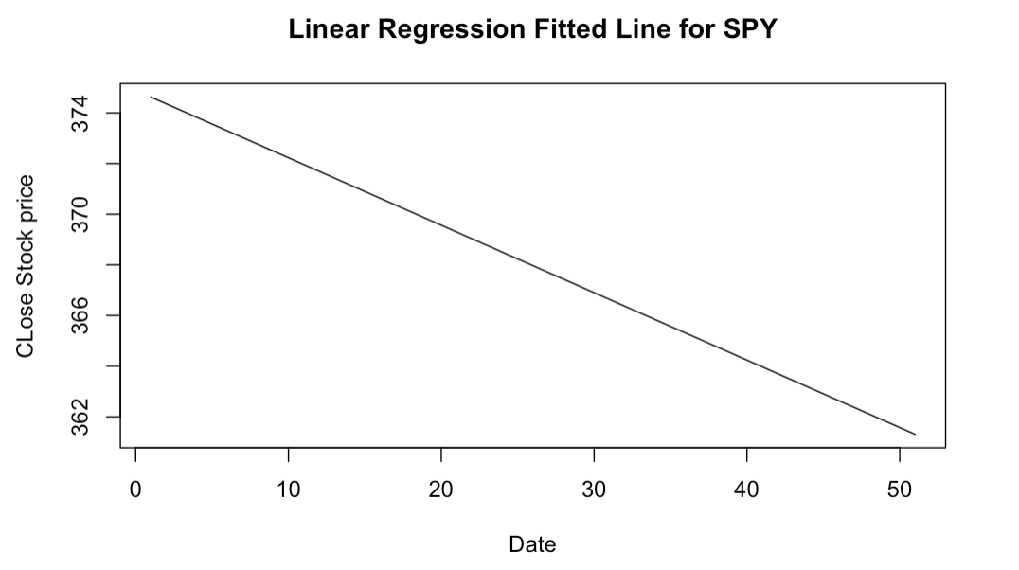
Linear Regression-SPY
Fitted model:
Estimated Close Stock Price = 428.15 - 0.27 * Date
MSE for Testing Data: 1091.003
Photo by Pexels

Slide 10
Linear Regression-Rest
Fitted model
IBB: Estimated Close Stock Price = 108.5 - 0.032 * Date
MRNA: Estimated Close Stock price = 131.93 + 0.24 * Date
XLE: Estimated Close Stock Price = 56.39 + 0.006 * Date
XLF: Estimated Close Stock Price = 24.3 + 0.01 * Date
XLRE: Estimated Close Stock Price = 44.72 - 0.04 * Date
AAPL: Estimated Close Stock Price = 155.60 - 0.08 * Date
MSE for Testing Data
IBB: 340.974
MRNA: 1227.69
XLE: 463.74
XLF: 13.93
XLRE: 8.48
AAPL: 368.10
Photo by Pexels

Slide 11
Linear Regression-Summary
STOCK | MSE for the Testing Data
SPY | 1091.003
IBB | 340.974
MRNA | 1227.69
XLE | 463.74
XLF | 13.93
XLRE | 8.48
AAPL | 368.1
Photo by Pexels

Slide 12
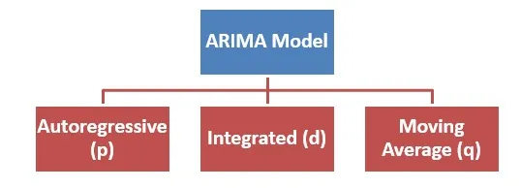
Traditional Models-ARIMA
ARIMA stands for Autoregressive Integrated Moving Average.
Specified by three parameters
p: number of autoregressive terms
d: number of non-seasonal differences
q: number of moving average terms
One of the most common statistical models for forecasting time series
Photo by Pexels

Slide 13
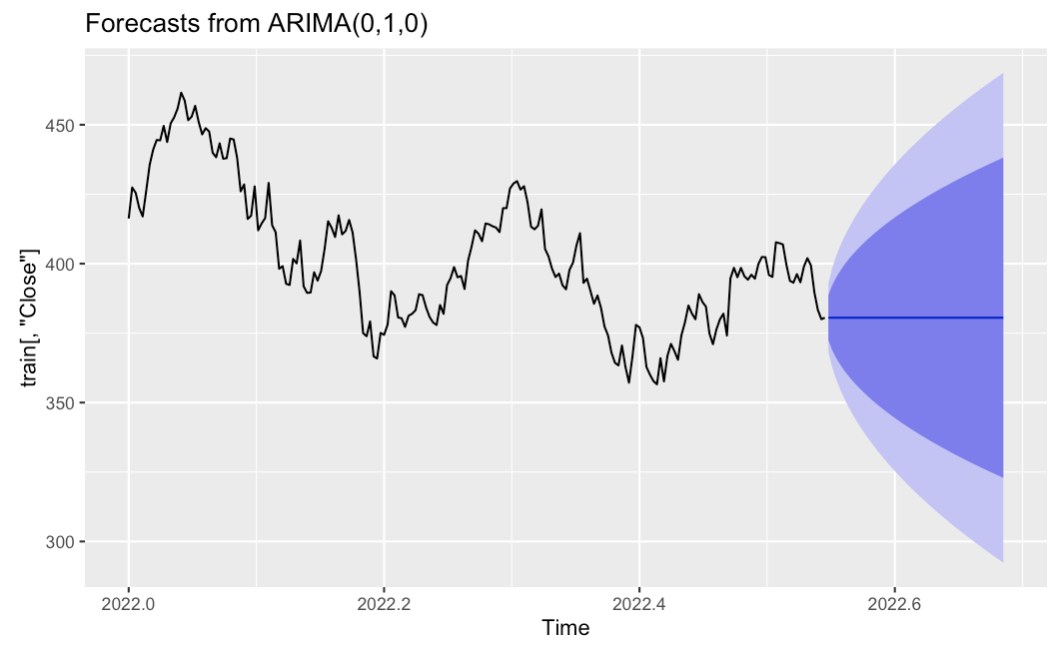
ARIMA-SPY
MSE for the Testing Data: 307.3
Photo by Pexels

Slide 14
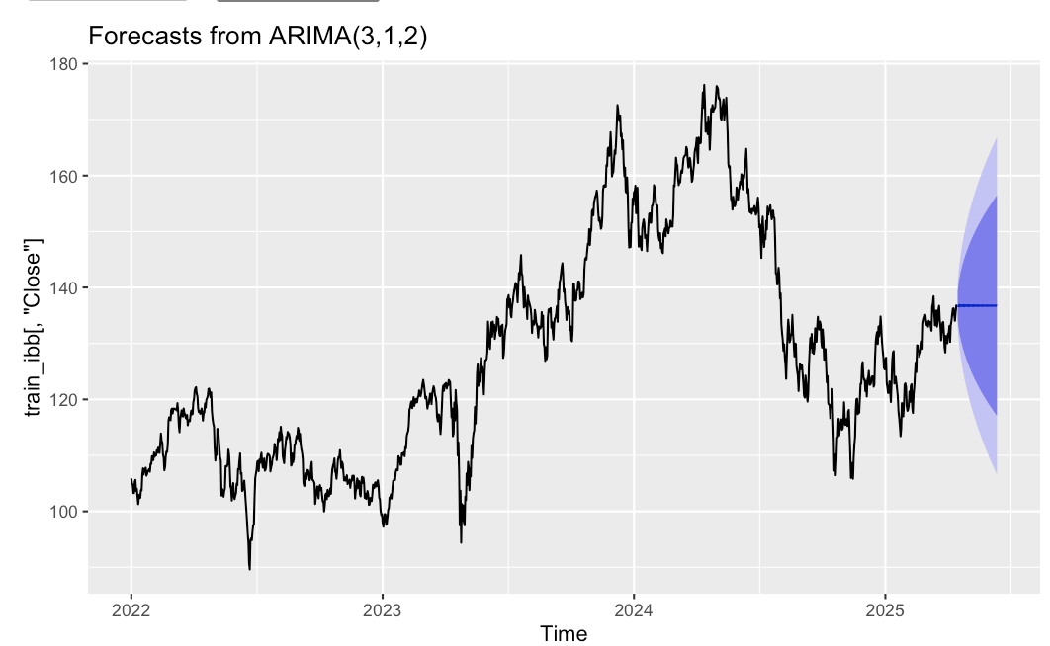
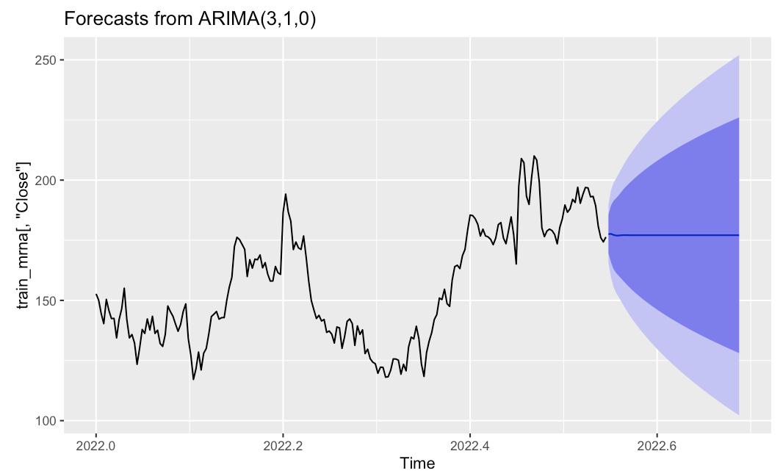
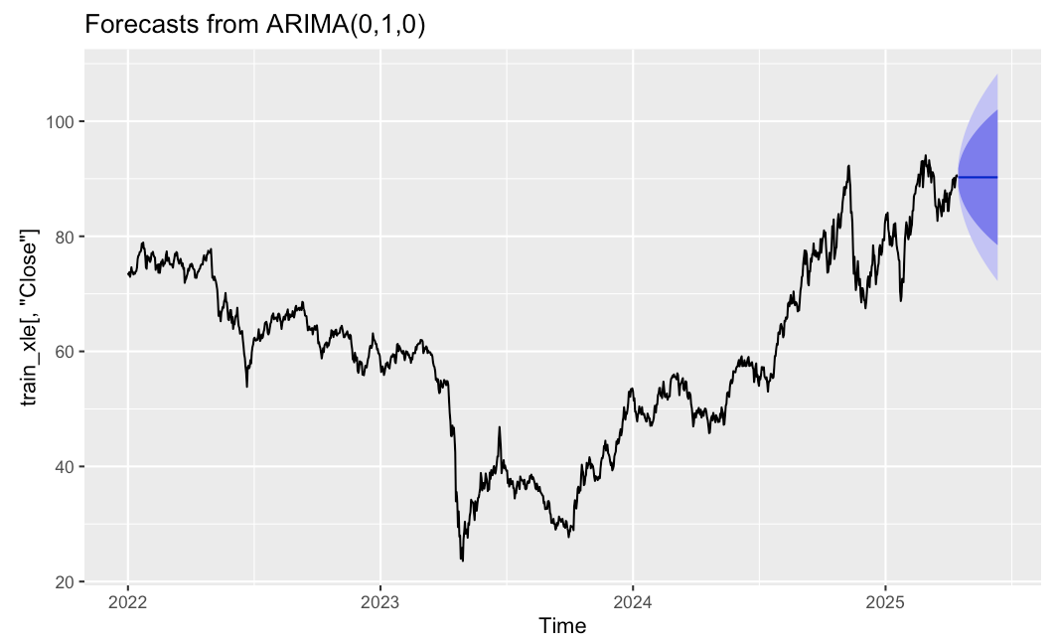
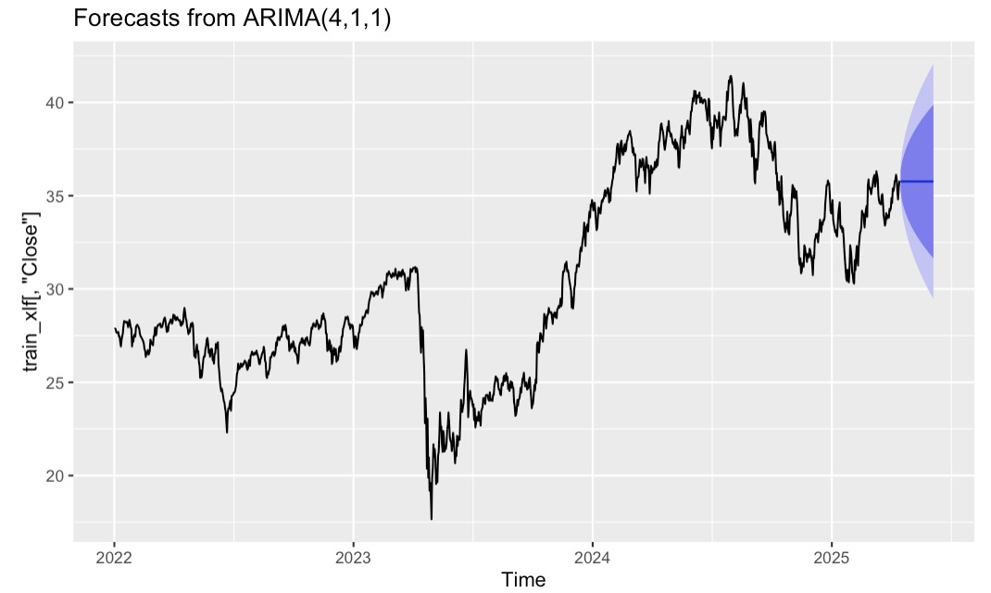
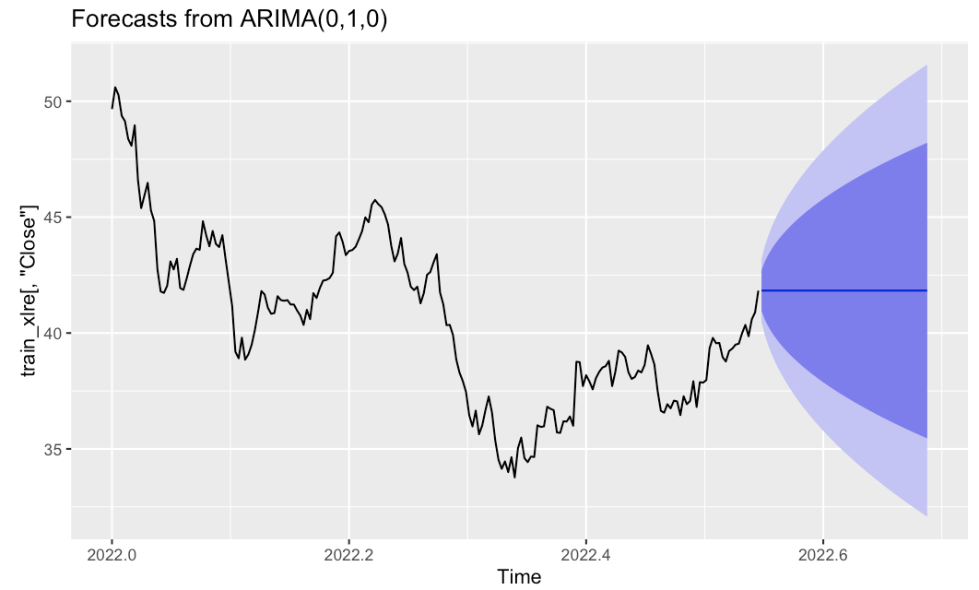
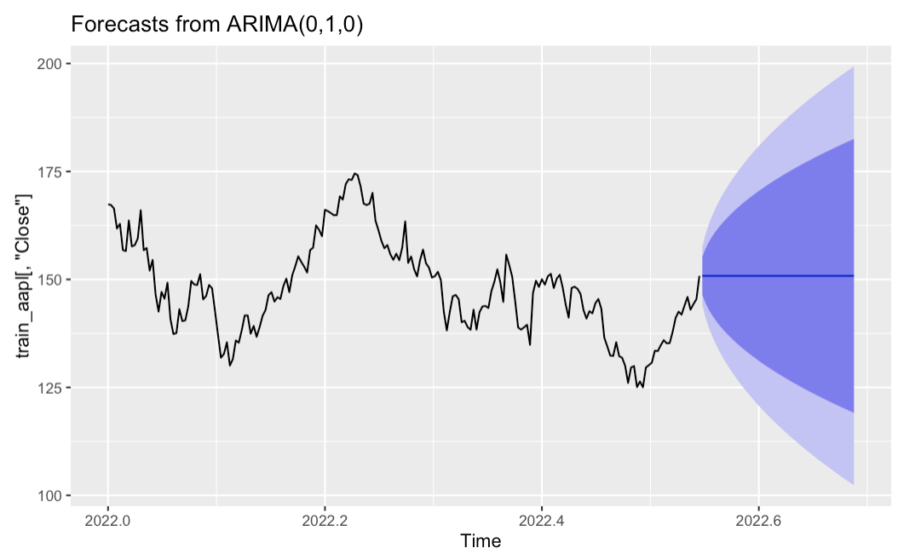
ARIMA-Rest
MSE for the Testing Data
IBB: 43.555
MRNA: 563.26
XLE: 307.3
XLF: 2.596
XLRE: 2.596
AAPL: 26.37
Photo by Pexels

Slide 15
ARIMA-Summary
STOCK | MSE for the Testing Data
SPY | 307.3
IBB | 43.555
MRNA | 563.26
XLE | 307.3
XLF | 2.596
XLRE | 16.41
AAPL | 26.37
Photo by Pexels
Notes:
Mention that (0,1,0) was mostly chosen.

Slide 16

Traditional Models-ARCH
ARCH stands for Autoregressive Conditional Heteroskedasticity.
Describes and forecasts time series data with changing levels of volatility over time
Specified by two components
Autoregressive component-captures the persistence of volatility shocks
Variance component-captures the impact of past forecast errors on the current variance
Photo by Pexels

Slide 17

ARCH
After gaining a p-value < 2.2e-16 from the ArchTest() function, we conclude the presence of ARCH(1) effects, suggesting heteroscedasticity for all models.
STOCK | MSE for the Testing Data
SPY | 26.37
IBB | 107.66
MRNA | 150.03
XLE | 619.19
XLF | 37.46
XLRE | 2.42
AAPL | 81.53
Photo by Pexels

Slide 18
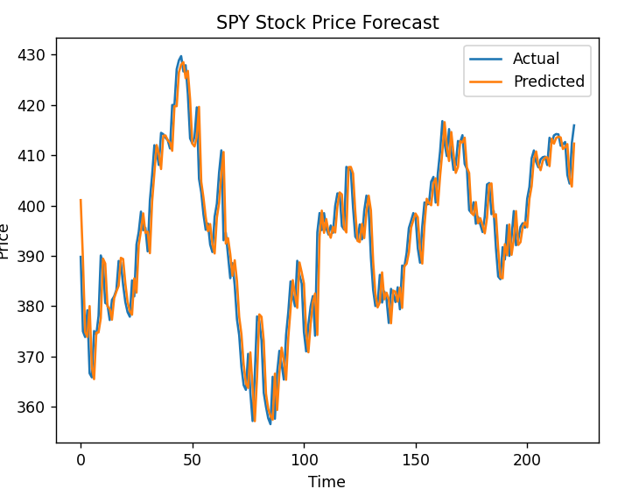
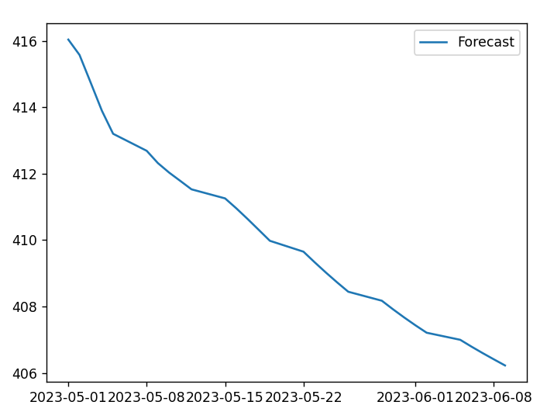
LSTM - SPY
MSE : 27.957
Notes:
Harsh

Slide 19
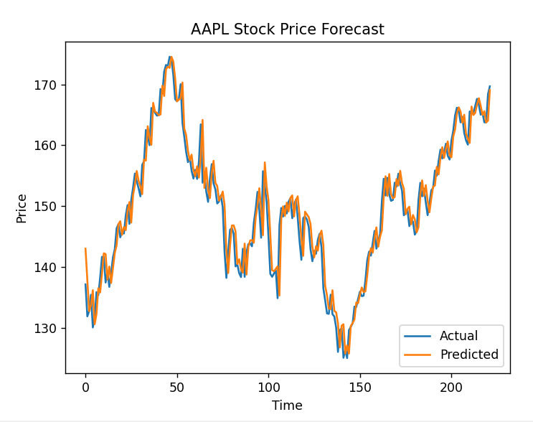
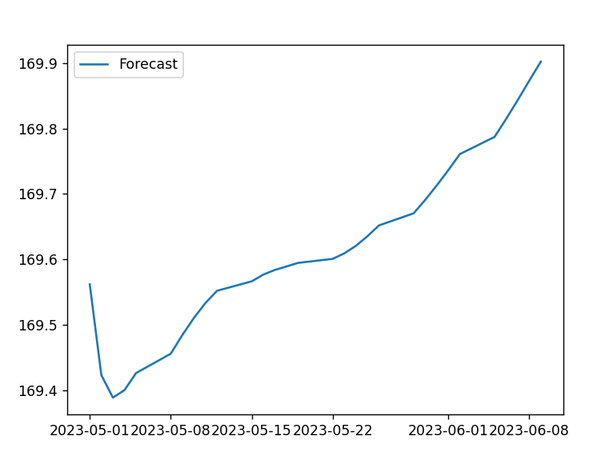
LTSM - AAPL
MSE : 8.791

Slide 20
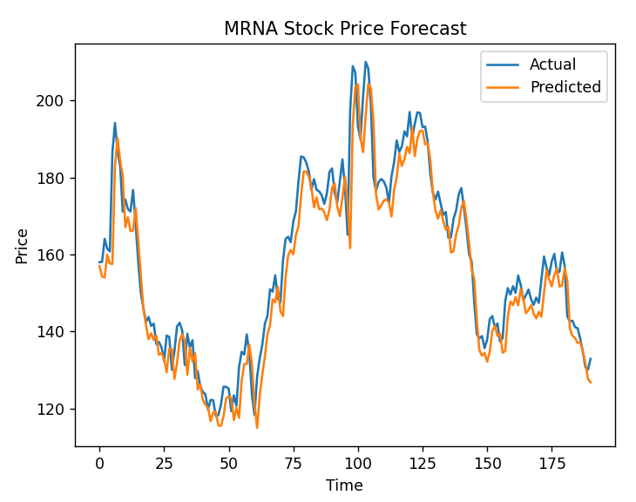
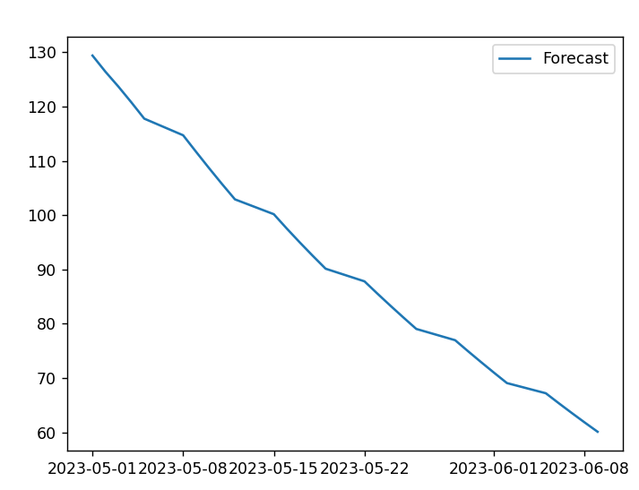
LSTM - MRNA
MSE : 40.322

Slide 21
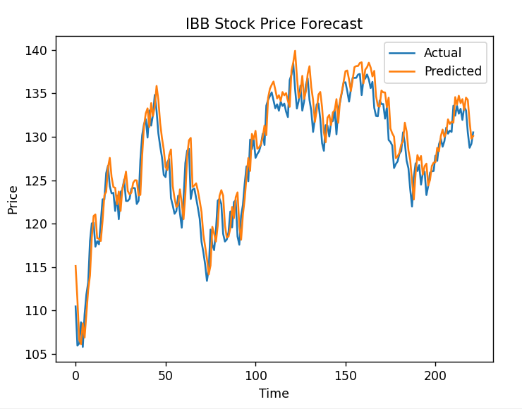
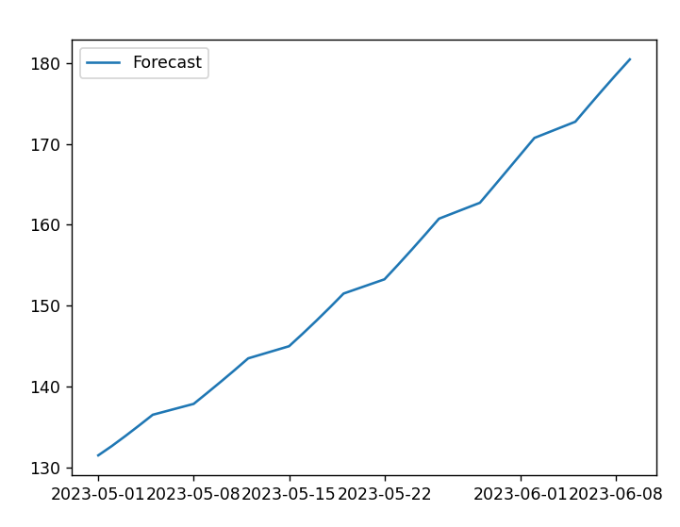
LSTM - IBB
MSE : 4.93

Slide 22
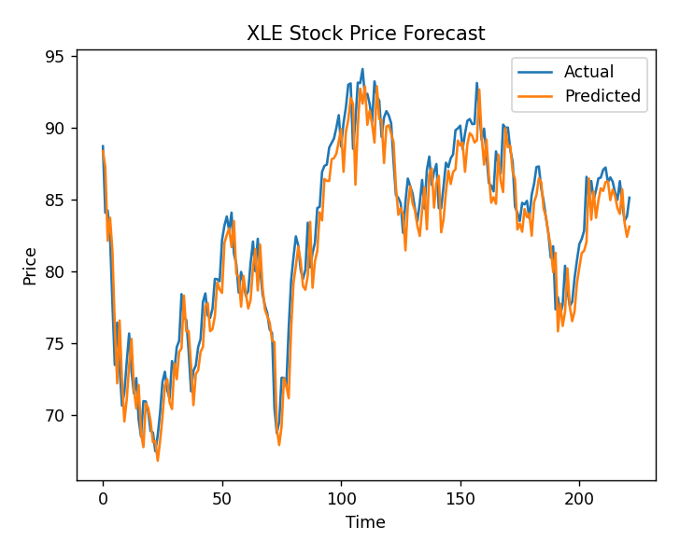
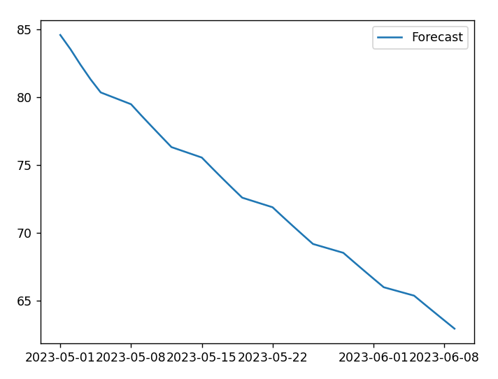
LSTM - XLE
MSE : 3.72

Slide 23
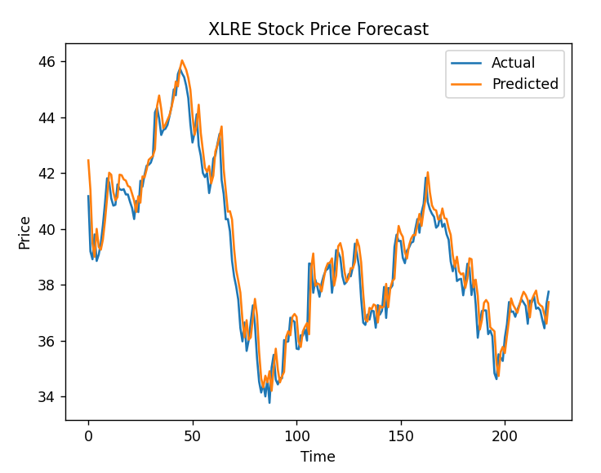
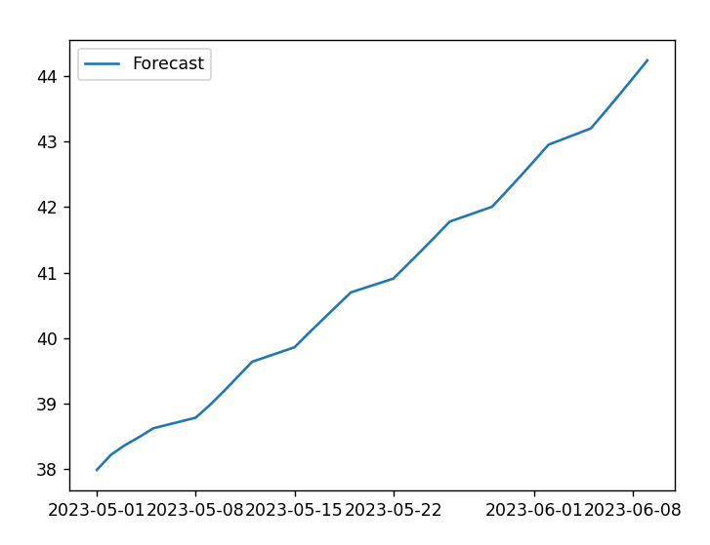
LSTM - XLRE
MSE : 0.449

Slide 24
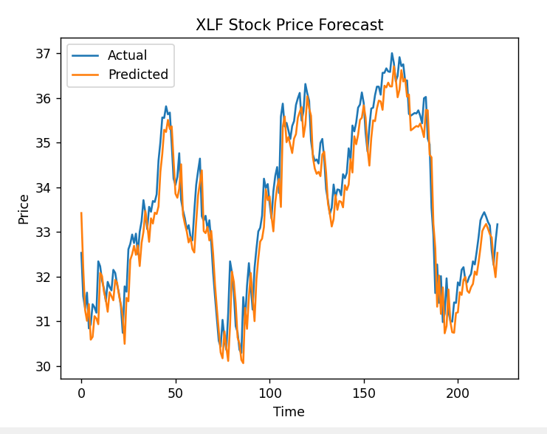

LSTM - XLF
MSE : 0.294

Slide 25
LSTM - Summary
STOCK | MSE
SPY | 27.957
AAPL | 8.791
MRNA | 40.322
IBB | 4.93
XLE | 3.72
XLRE | 0.449
XLF | 0.294

Slide 26
Results
STOCK(MSE) | LSTM | ARCH | ARIMA | Lin Reg
SPY | 27.96 | 26.37 | 307.30 | 1091.01
IBB | 4.93 | 107.66 | 43.55 | 340.97
MRNA | 40.32 | 150.03 | 563.26 | 1227.69
XLE | 3.72 | 619.19 | 307.30 | 463.74
XLF | 0.29 | 37.46 | 2.60 | 13.93
XLRE | 0.45 | 2.42 | 16.41 | 8.48
AAPL | 8.79 | 81.53 | 26.37 | 368.10
Notes:
Harsh

Slide 27
Conclusion
For SPY, ARCH model has the lowest MSE value of 26.37 for the testing data.
For the rest of the datasets, the LSTM model has the lowest MSE values for the testing datasets.
We can conclude that the best method to forecast stock prices in various sectors of SPY would be the LSTM model generally. ARIMA model outperforms ARCH model in most stocks, with the exception of SPY and Moderna.
Next step: Finding out the reason why ARIMA performs better among the traditional methods in the context of predicting stock prices.
Photo by Pexels
Notes:
Mingli

